Slide 1
Test API with Postman
Ding Xianli
2017.5.10

Slide 2
Tools
Postman: https://www.getpostman.com/
Json Schema: http://json-schema.org/
Newman: https://www.getpostman.com/docs/newman_intro
Jenkins: https://jenkins.io/index.html

Slide 3
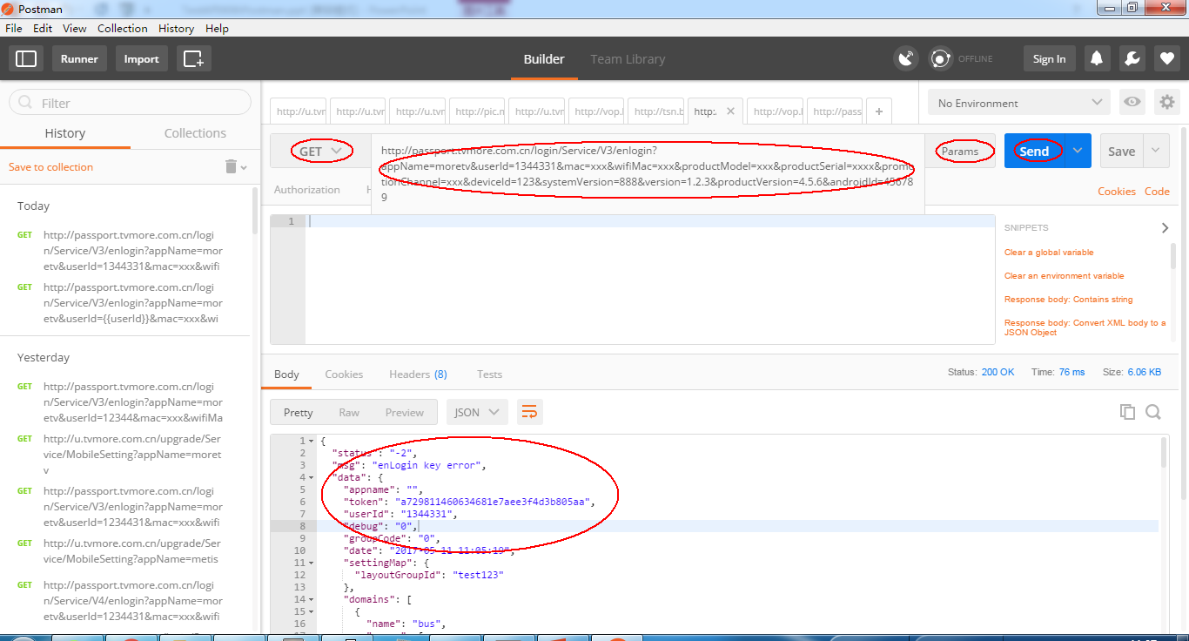
Send Request

Slide 4
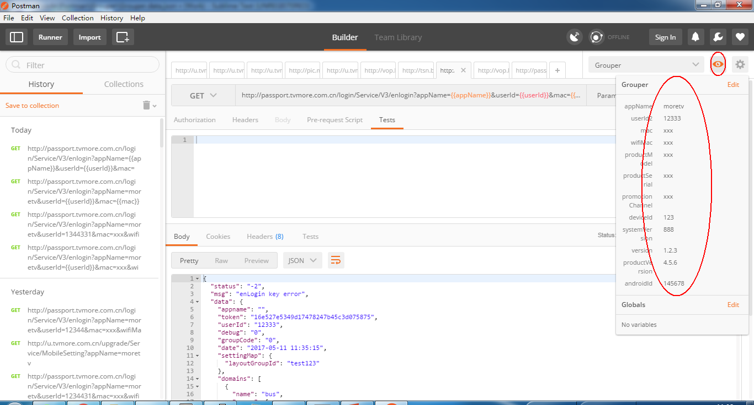
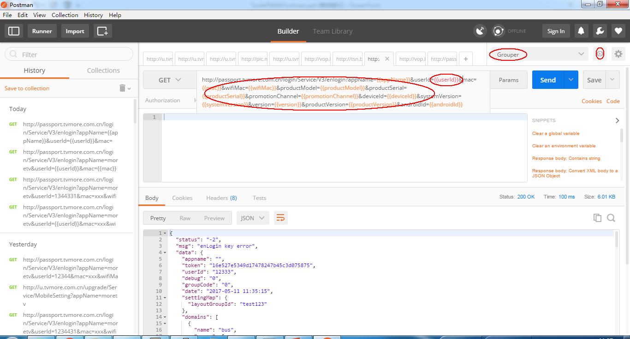
Configure Variables

Slide 5
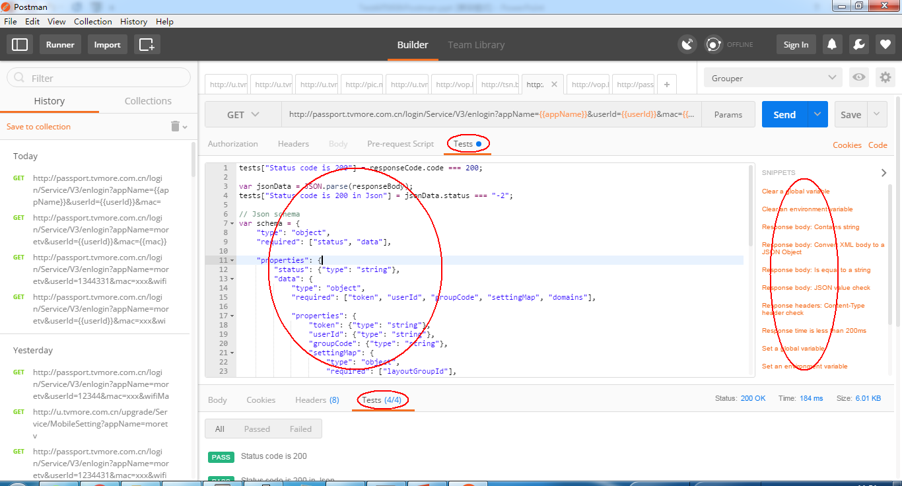
Write Tests
Check value
Json schema

Slide 6
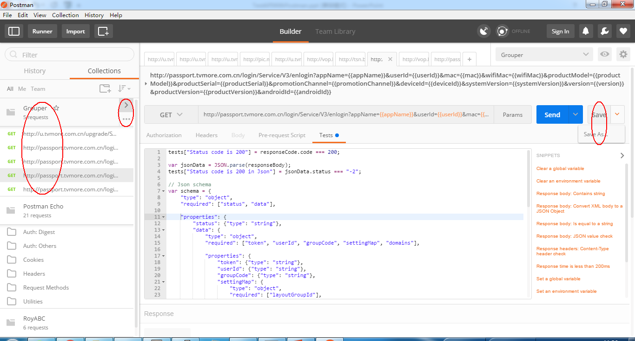
Save Collection
Run
Export

Slide 7
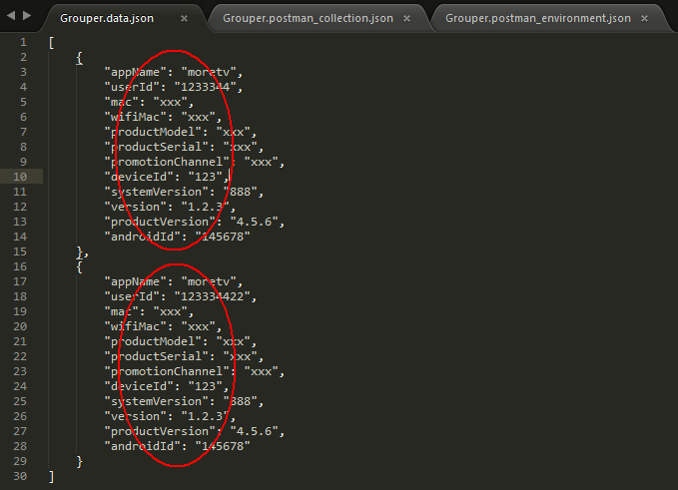
Create Data File
Json or csv

Slide 8
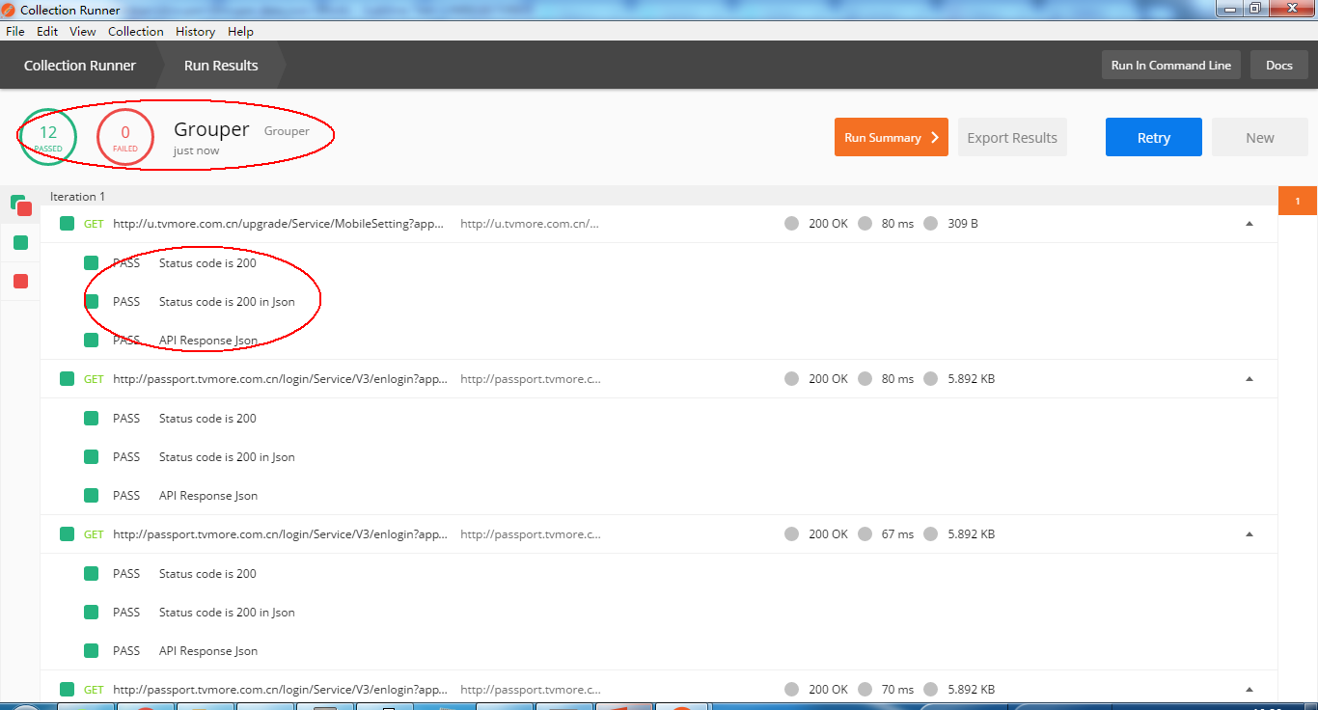
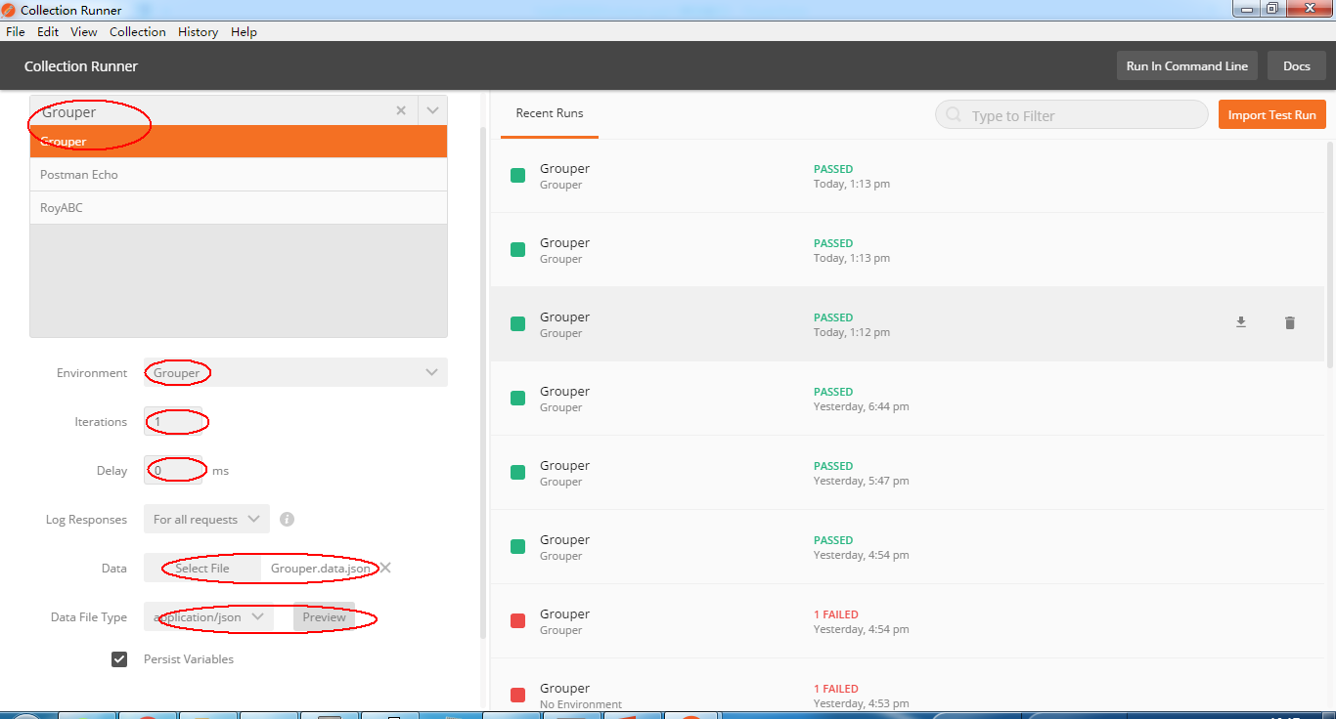
Run in Collection Runner

Slide 9
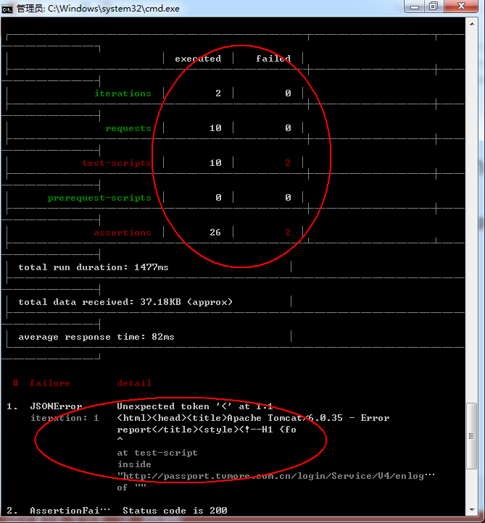
Run in Command Line
newman run Grouper.postman_collection.json --folder v3 -d Grouper.data.json

Slide 10
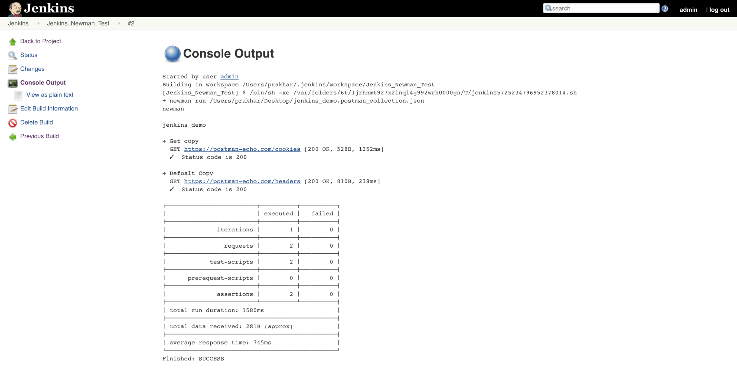
Integrate with Jenkins
https://www.getpostman.com/docs/integrating_with_jenkins

